Slide 1

Pandamo – Data Science for Dynamo

Slide 2

Disclaimer
This is an experimental pre-alpha-beta-alpha package
If anything breaks during this presentation, I will blame one of the following:
Dynamo!
Autodesk
My laptop
The weather

Slide 3
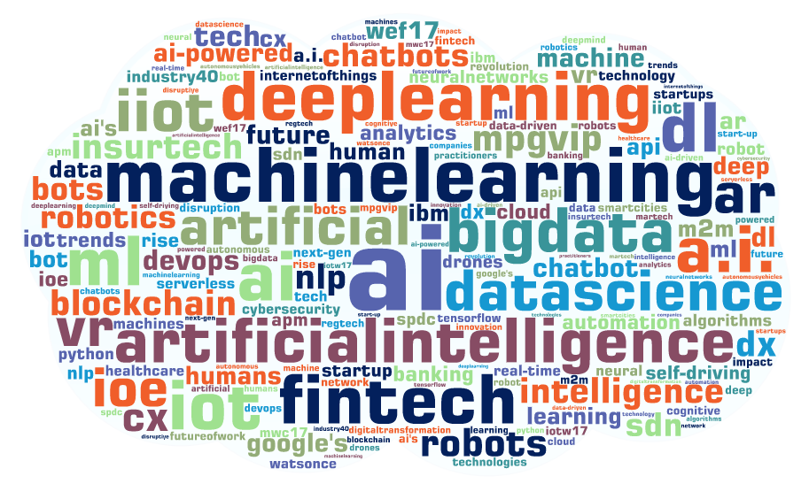
AEC 2019 Presentation – Machine Learning

Slide 4

Machine Learning is “Easy!”

Slide 5
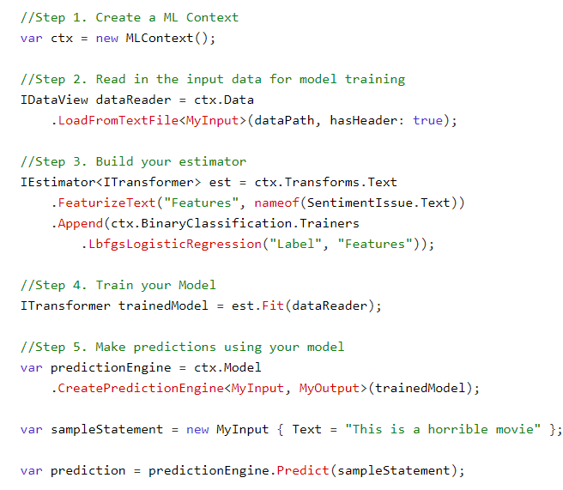
ML in C#

Slide 6
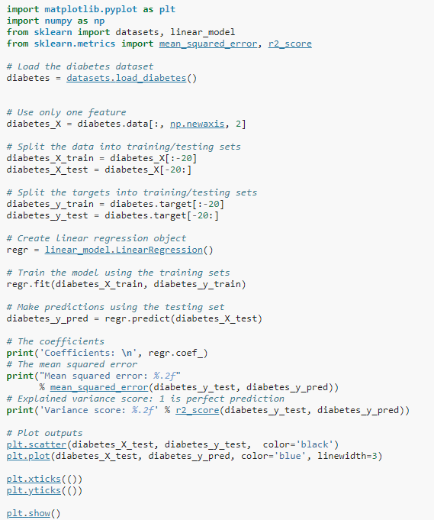
ML in Python (Scikit-Learn)

Slide 7
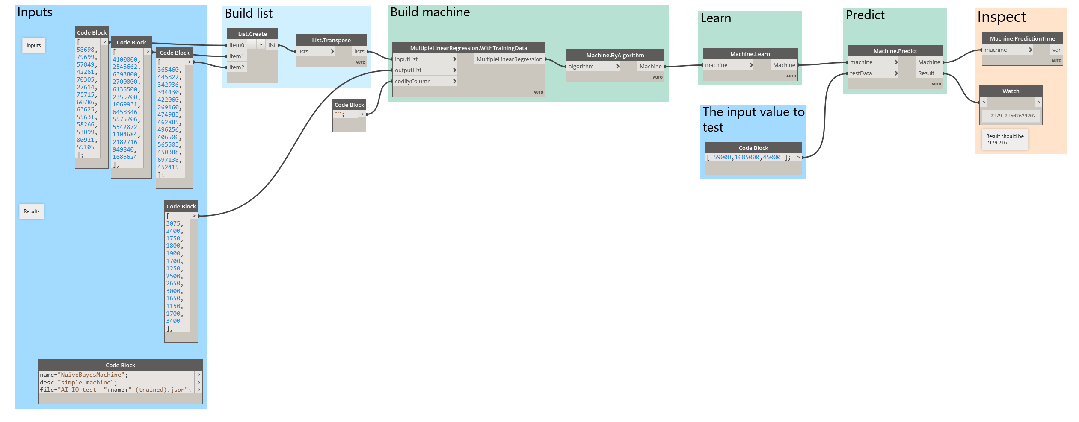
ML in Dynamo (DynAI)

Slide 8

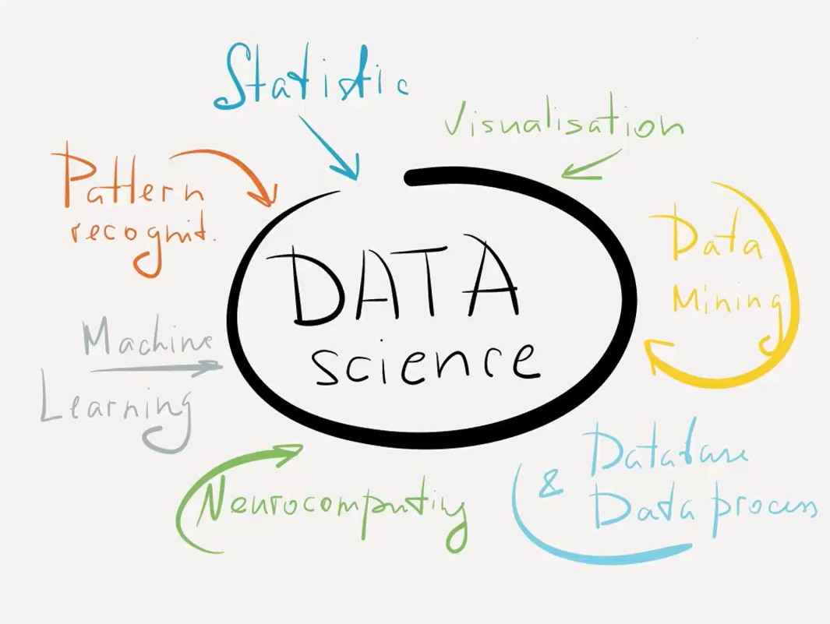
The Difficult Part!

Slide 9
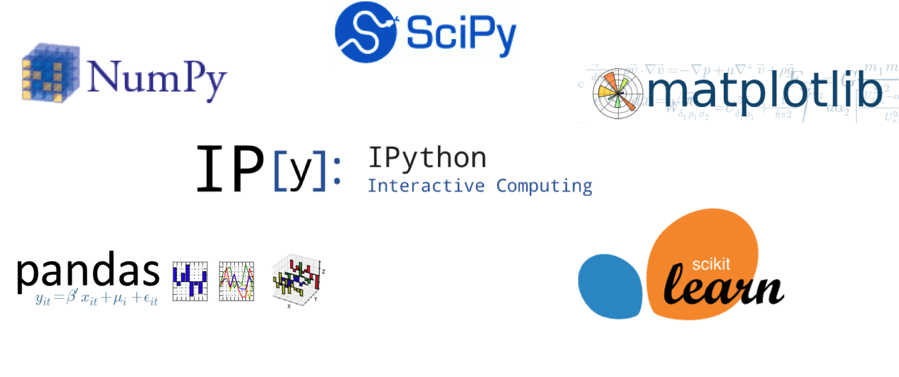
Python is the most popular language in Data Science

Slide 10
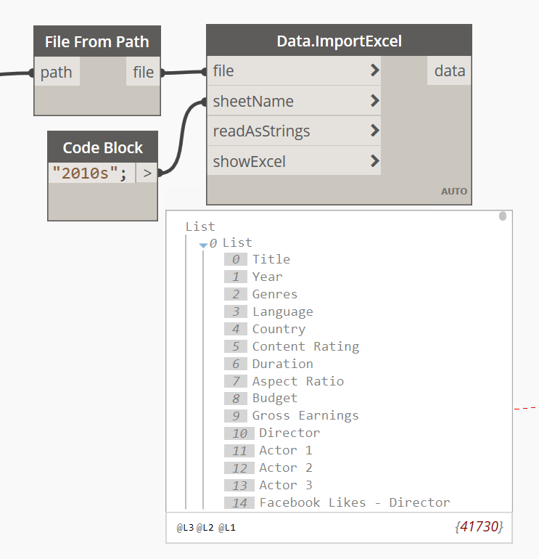
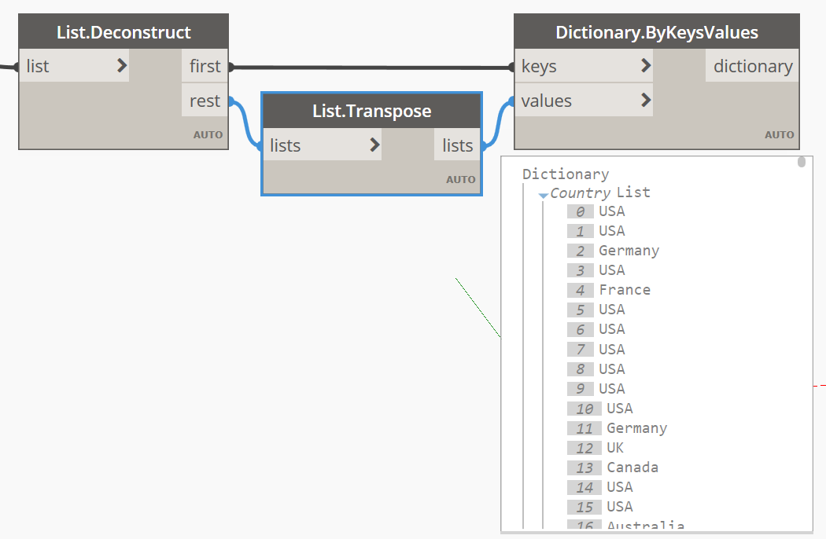
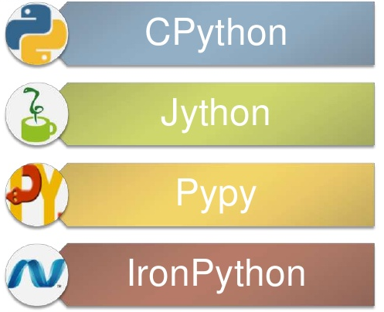
Limitations of Dynamo

Slide 11
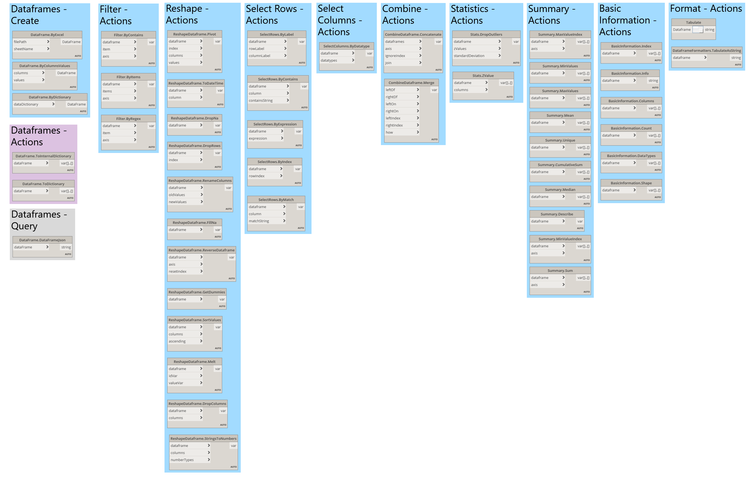
Pandas for Dynamo
Pandamo
Pandas for Dynamo
49 nodes – broken down by 10 categories
1 view extension to connect Dynamo with Python

Slide 12



The Tech
View Extension
Zero-Touch Nodes

